Slide 1
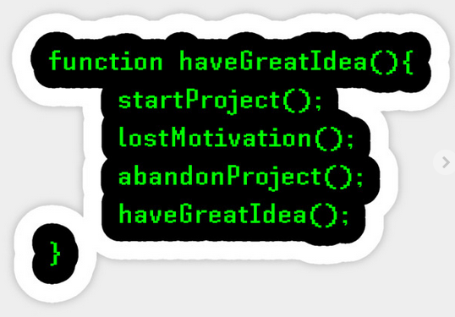
Modular Programs
Developing User Defined Functions

Slide 2
What is modular programming?
Break down problem statement to individual sub-programs
Functions hide implementation details
Define functions that are functionally-cohesive (single operation)
Define parameters that provide for function reuse

Slide 3
Three Parts of a Function
Function declaration (prototype)
type identifier (parameter-list);
Function definition
type identifier (parameter-list) {
body-statements;
return-statement;
}
Function call
[variable =] identifier(values);

Slide 4
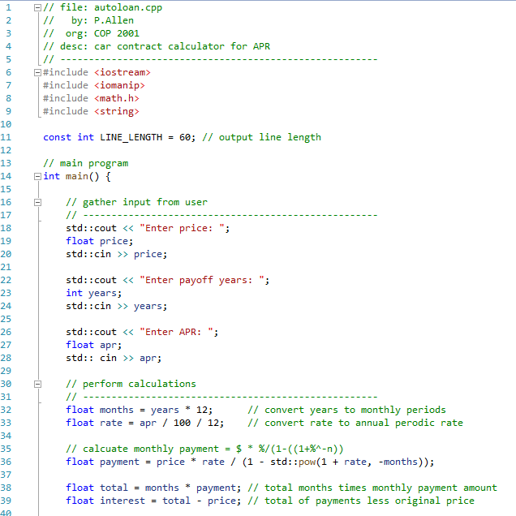
Review the Auto Loan Program
File header comment block
Includes
Global constants
Gather input
Calculate values

Slide 5
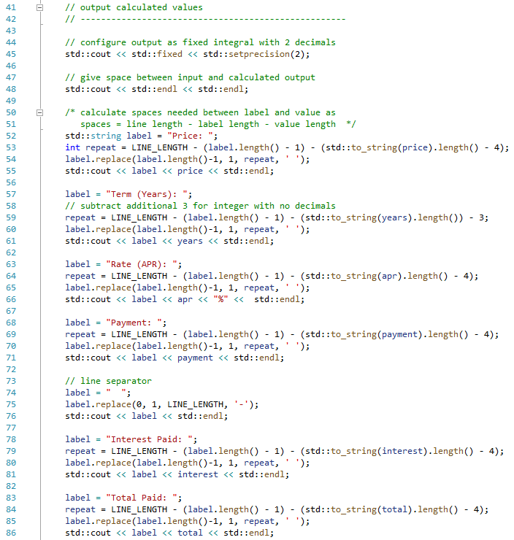
Auto Loan Outputs
Configure outputs
Create space
Output value
Assign label
Calculate spaces
Update label with spaces
Output label and value
Repeated code
Try to modularize
What is different in each one?

Slide 6
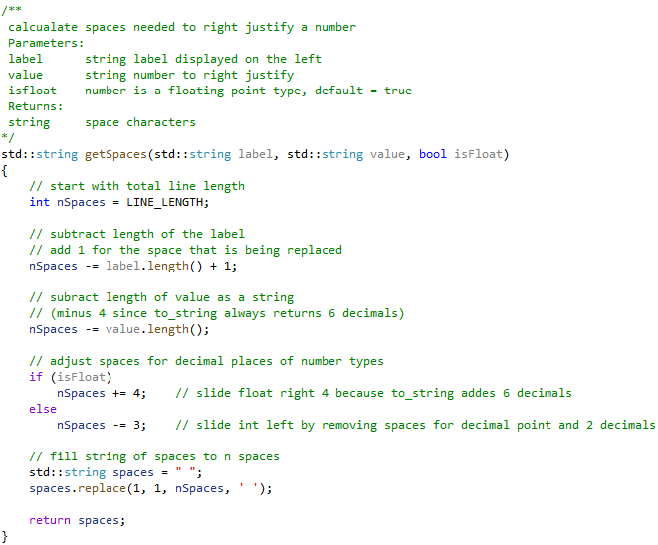
Define Get Spaces to Right Justify Value
Define functions below main()
Function header comment block
Description
Parameter descriptions
Return type & description
Function definition
Return type (may be void)
Identifier
Parameter definitions
Function body
Function return
Not required if void
Note: /** … */
Context sensitive help picks up this combination

Slide 7
Declare Get Spaces to Right Justify Value
Declare function prototypes above main()
Function prototype statement:
Return type
Identifier
Parameter List (Required)
Only types are required
May include parameter identifiers (Recommended)
Optional default values may be provided
should be at end of list

Slide 8
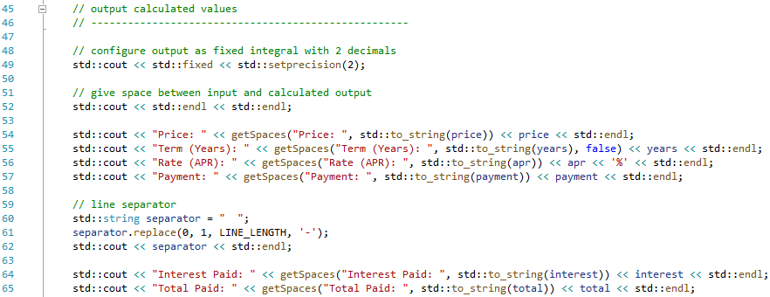
Call Get Spaces to Right Justify Value
Function call
Returns value to the left
Provide arguments for each parameter
Optionally override default parameter values with argument value
label
value
isFloat

Slide 9
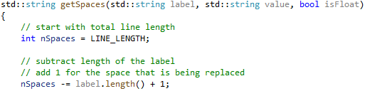
Match Parts of Function
Function declaration (prototype)
Values passed to function must match definition by number and type
Function call
Arguments
Values of local variables and literals are copied into parameters by position
Function definition
Parameters are variables that only exist within the function’s scope

